Slide 1
Advanced Computer Architecture
Out-of-Order Execution

Slide 2
HW to get CPI Closer to 1
Why in HW at run time?
  Works when can’t know real dependence at compile time
  Compiler simpler
  Code for one machine runs well on another
Key idea: Allow instructions behind stall to proceed
DIVD F0,F2,F4
ADDD F10,F0,F8
SUBD F12,F8,F14
Out-of-order execution => out-of-order completion.

Slide 3
Typical Pipeline
Integer unit
e1
e2
FP/Int Multiply
IF
ID
m1
m2
m3
…
m8
m9
m10
MEM
WB
FP adder
a1
a2
a3
a4
FP/Int divider
Div (lat = 25, Init inv=25)

Slide 4
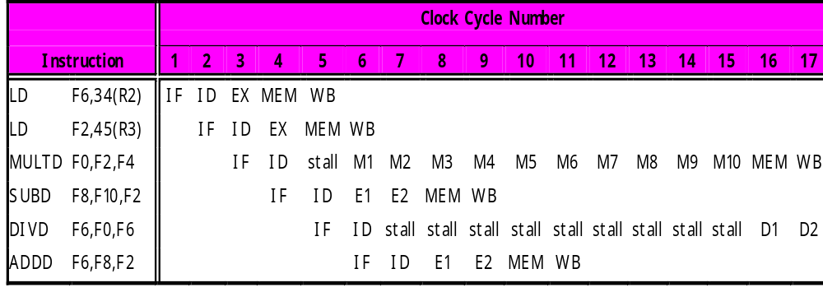
WAR and WAW
How do we prevent WAR and WAW?
How do we deal with variable latency?
  Forwarding for RAW hazards harder.
RAW
WAR

Slide 5
Scoreboard
Out-of-order execution divides ID stage:
  1. Issue - decode instructions, check for structural hazards
  2. Read operands - wait until no data hazards, then read operands
Scoreboards date to CDC6600 in 1963
Instructions execute whenever not dependent on previous instructions and no hazards.
CDC 6600: In order issue, out-of-order execution, out-of-order commit (or completion)
  No data forwarding
  Imprecise interrupt/exception model for now

Slide 6
Scoreboard Architecture
(CDC 6600)
FP Mult
FP Mult
FP Divide
Registers
Functional Units
FP Add
Integer
SCOREBOARD
Memory

Slide 7
Scoreboard Implications
Out-of-order completion => WAR, WAW hazards?
Solutions for WAR:
  Stall WB until registers have been read
  Read registers only during Read Operands stage
Solution for WAW:
  Detect hazard and stall issue of new instruction until other instruction completes
Need to have multiple instructions in execution phase => multiple execution units or pipelined execution units
Scoreboard keeps track of dependencies between instructions that have already issued.
Scoreboard replaces ID, EX, WB with 4 stages

Slide 8
Four Stages of Scoreboard Control
Issue—decode instructions & check for structural hazards (ID1)
  Instructions issued in program order (for hazard checking)
  Don’t issue if structural hazard
  Don’t issue if instruction is output dependent on any previously issued but uncompleted instruction (no WAW hazards)
Read operands—wait until no data hazards, then read operands (ID2)
  All real dependencies (RAW hazards) resolved in this stage, since we wait for instructions to write back data.
  No forwarding of data in this model!

Slide 9
Four Stages of Scoreboard Control
Execution—operate on operands (EX)
  The functional unit begins execution upon receiving operands. When the result is ready, it notifies the scoreboard that it has completed execution.
Write result—finish execution (WB)
  Stall until no WAR hazards with previous instructions:
  Example: DIVD F0,F2,F4
  ADDD F10,F0,F8
  SUBD F8,F8,F14
  CDC 6600 scoreboard would stall SUBD until ADDD reads operands

Slide 10
Three Parts of the Scoreboard
Instruction status:
Which of 4 steps the instruction is in
Functional unit status:—Indicates the state of the functional unit (FU). 9 fields for each functional unit
Busy: Indicates whether the unit is busy or not
Op: Operation to perform in the unit (e.g., + or –)
Fi: Destination register
Fj,Fk: Source-register numbers
Qj,Qk: Functional units producing source registers Fj, Fk
Rj,Rk: Flags indicating when Fj, Fk are ready
Register result status—Indicates which functional unit will write each register, if one exists. Blank when no pending instructions will write that register
Notes:
What you might have thought
1. 4 stages of instruction executino
2.Status of FU: Normal things to keep track of (RAW & structura for busyl):
Fi from instruction format of the mahine (Fi is dest)
Add unit can Add or Sub
Rj, Rk - status of registers (Yes means ready)
Qj,Qk - If a no in Rj, Rk, means waiting for a FU to write result; Qj, Qk means wihch FU waiting for it
3.Status of register result (WAW &WAR)s:
which FU is going to write into registers
Scoreboard on 6600 = size of FU
6.7, 6.8, 6.9, 6.12, 6.13, 6.16, 6.17
FU latencies: Add 2, Mult 10, Div 40 clocks

Slide 11
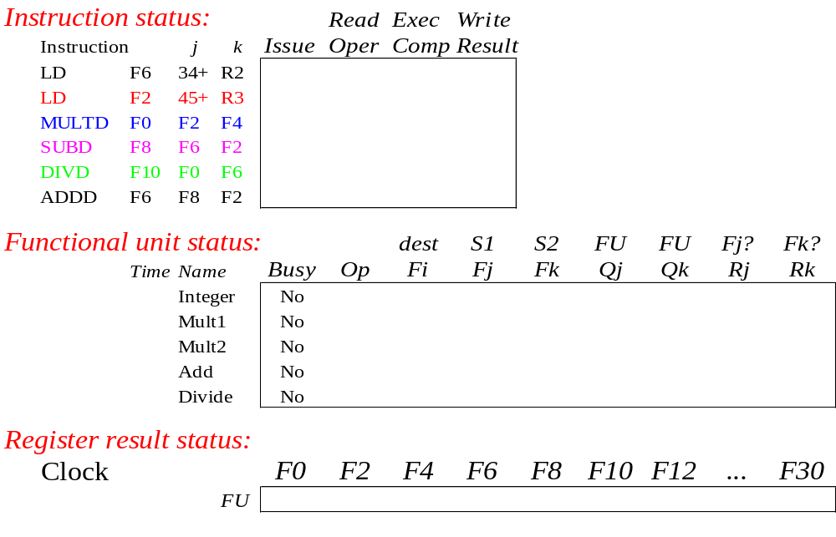
Scoreboard Example

Slide 12
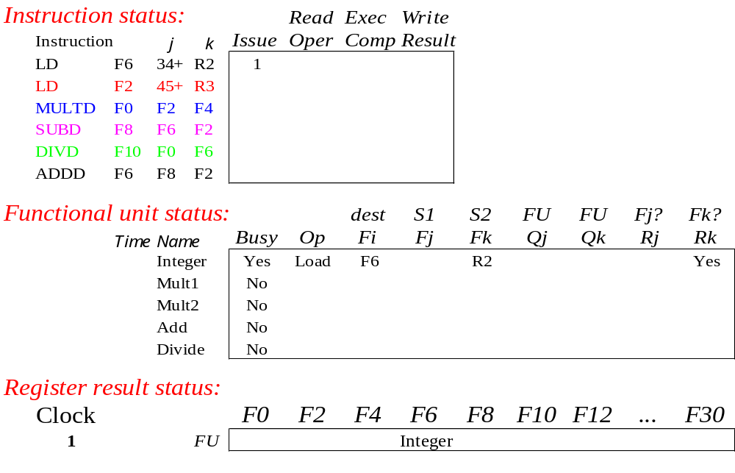
Scoreboard Example: Cycle 1

Slide 13

Scoreboard Example: Cycle 2
Cannot Issue 2nd LD – Structural Hazard

Slide 14

Scoreboard Example: Cycle 3
Issue MULT?

Slide 15
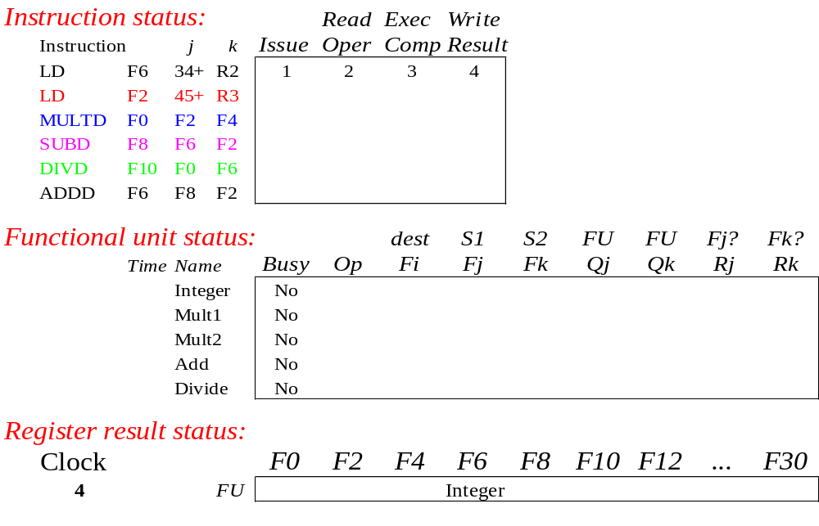
Scoreboard Example: Cycle 4

Slide 16
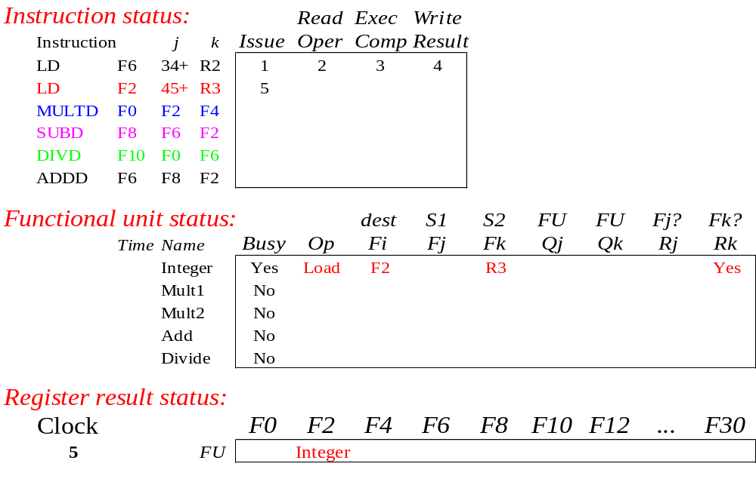
Scoreboard Example: Cycle 5

Slide 17
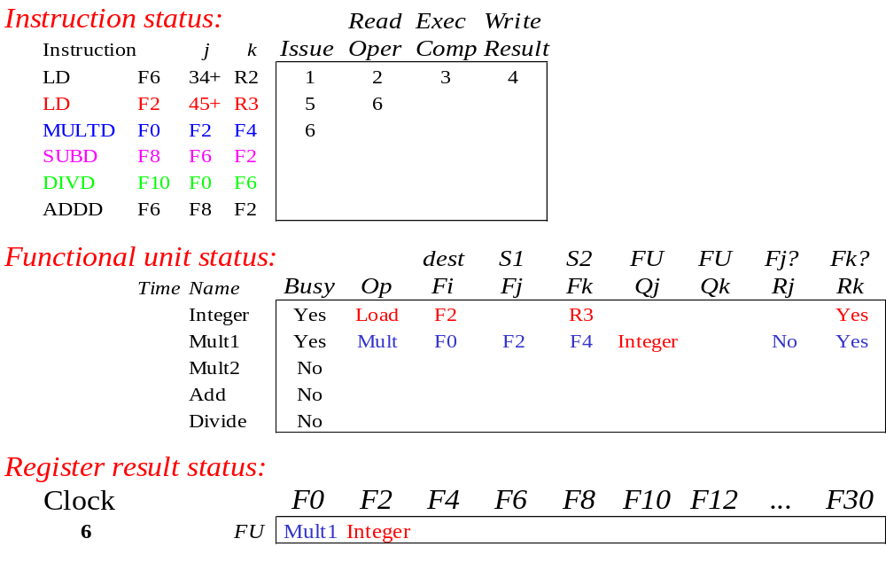
Scoreboard Example: Cycle 6

Slide 18
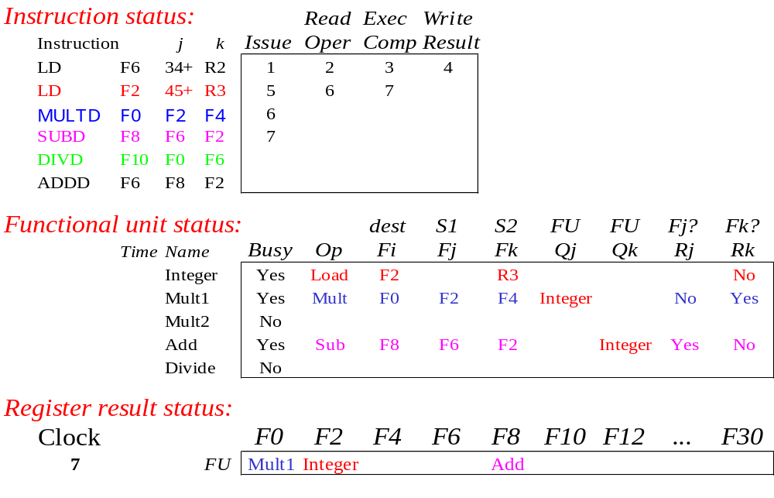
Scoreboard Example: Cycle 7
Read multiply operands?

Slide 19
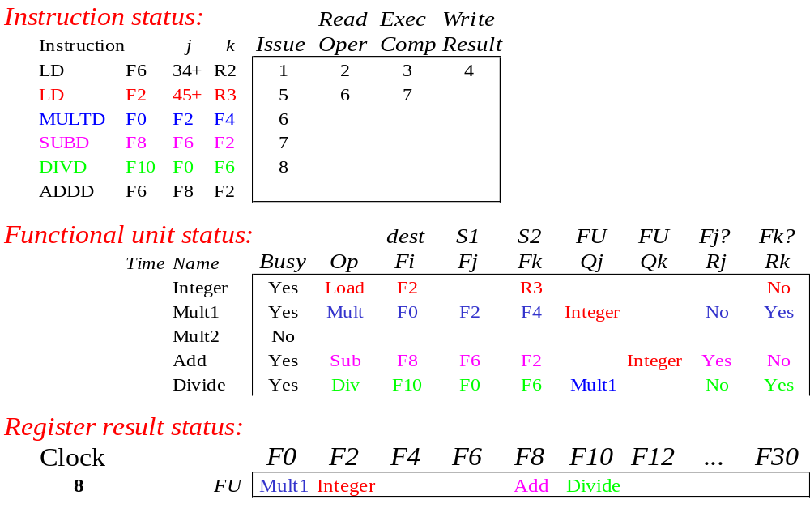
Scoreboard Example: Cycle 8a

Slide 20
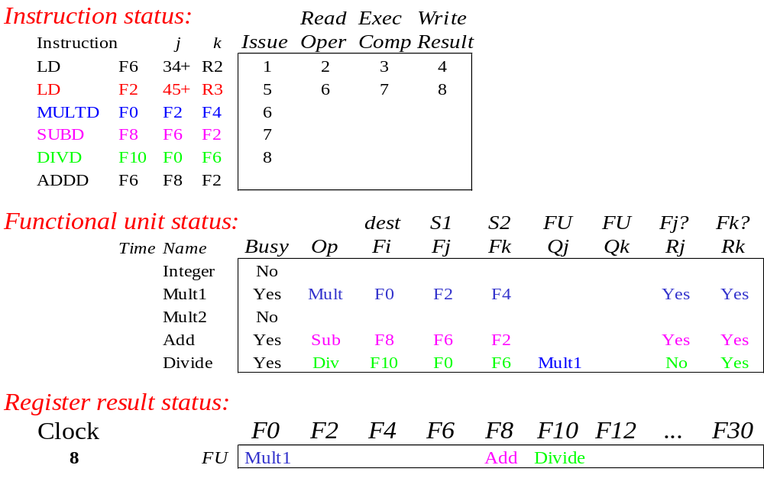
Scoreboard Example: Cycle 8b

Slide 21
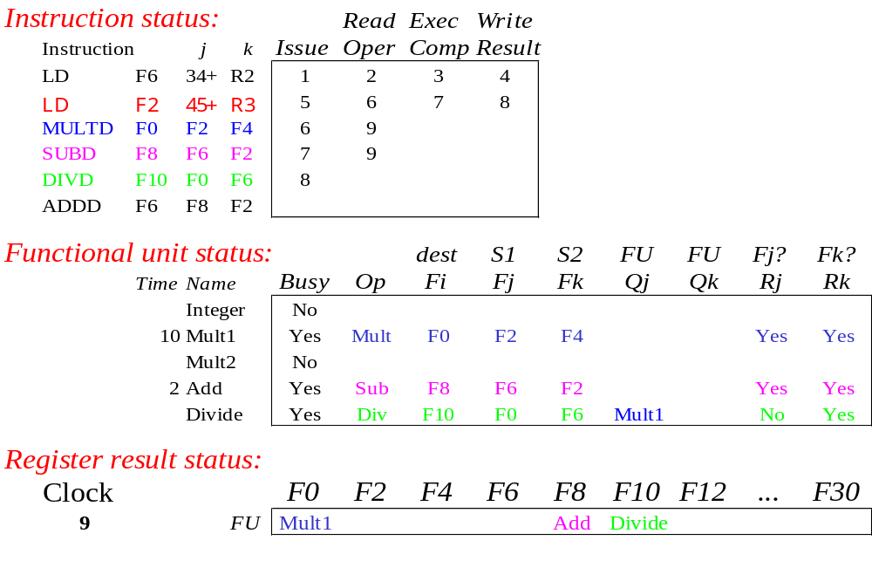
Scoreboard Example: Cycle 9
Note
Remaining
Read operands for MULT & SUB? Issue ADDD?

Slide 22

Scoreboard Example: Cycle 10

Slide 23

Scoreboard Example: Cycle 11

Slide 24
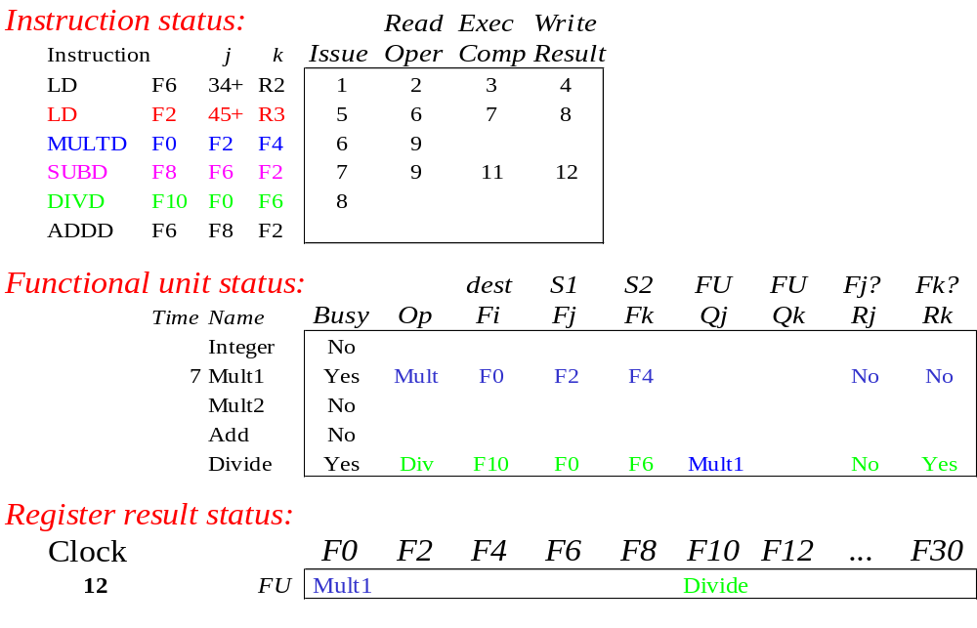
Scoreboard Example: Cycle 12
Read operands for DIVD?

Slide 25
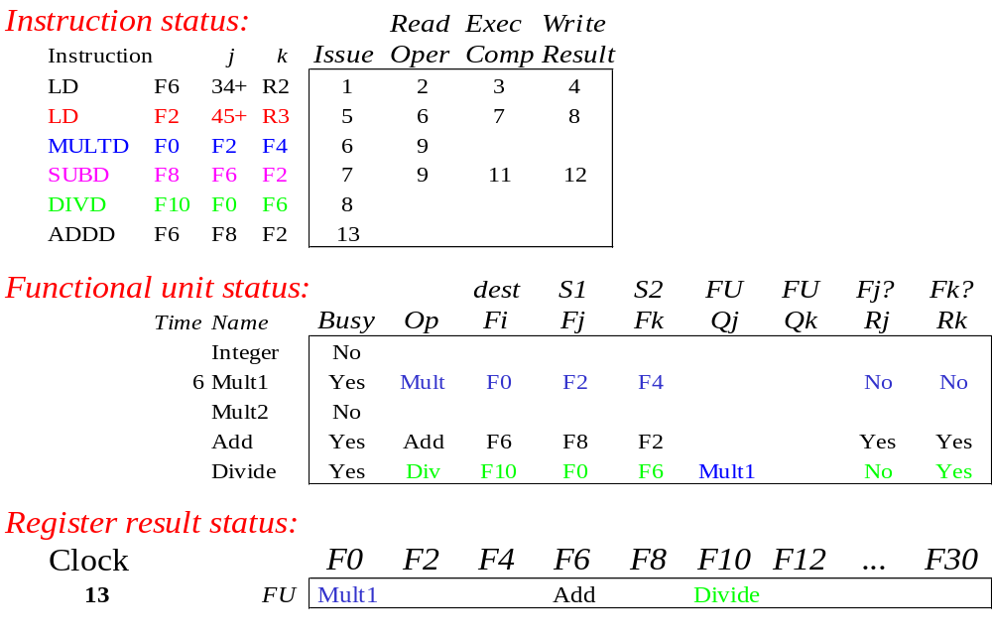
Scoreboard Example: Cycle 13

Slide 26
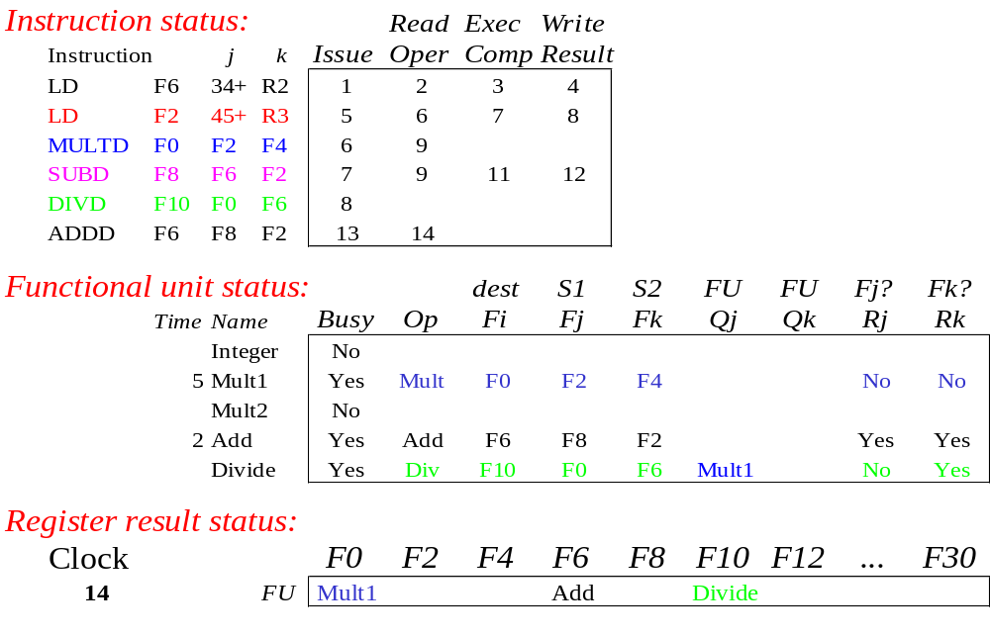
Scoreboard Example: Cycle 14

Slide 27

Scoreboard Example: Cycle 15

Slide 28

Scoreboard Example: Cycle 16

Slide 29

Scoreboard Example: Cycle 17
WAR Hazard!
Why not write result of ADD???

Slide 30

Scoreboard Example: Cycle 18

Slide 31
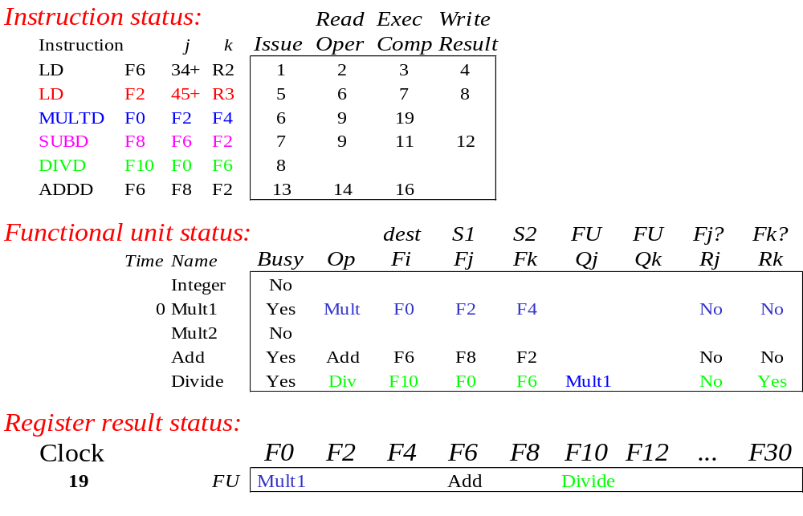
Scoreboard Example: Cycle 19

Slide 32
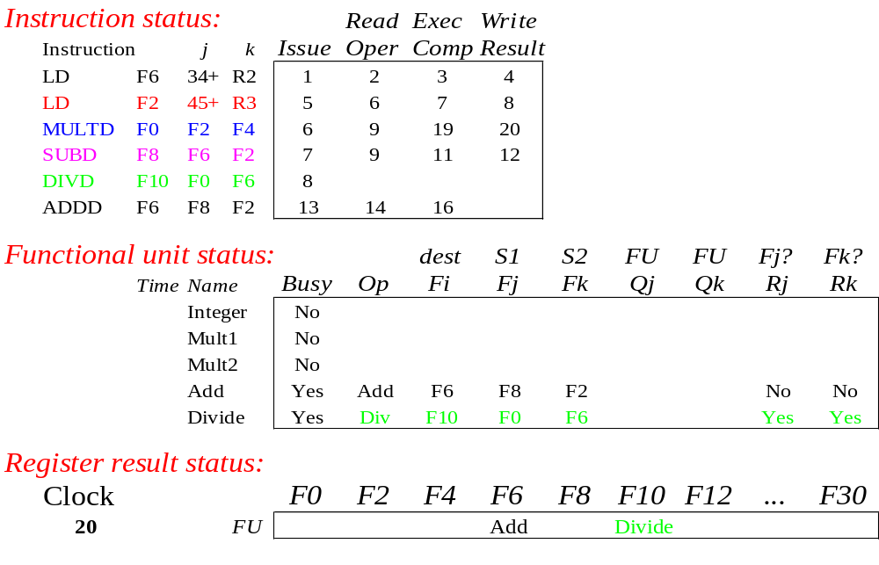
Scoreboard Example: Cycle 20

Slide 33

Scoreboard Example: Cycle 21
WAR Hazard is now gone...

Slide 34
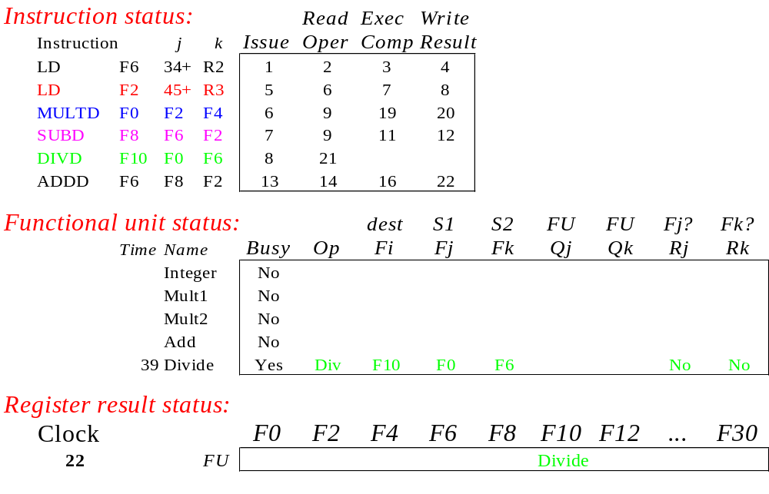
Scoreboard Example: Cycle 22

Slide 35
After Some Cycles

Slide 36
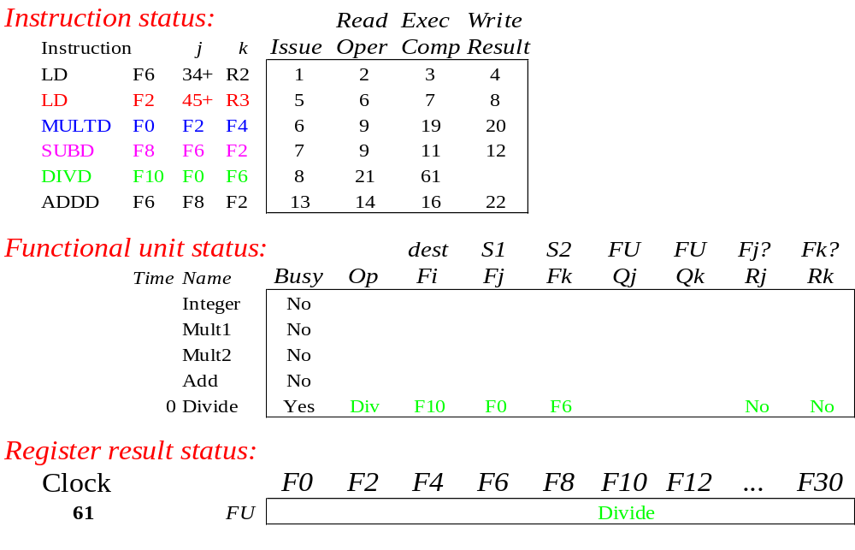
Scoreboard Example: Cycle 61

Slide 37
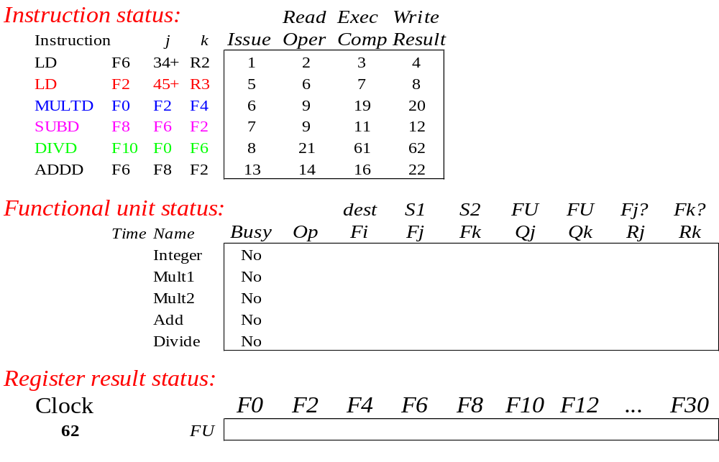
Scoreboard Example: Cycle 62

Slide 38
Review: Scoreboard Example: Cycle 62
In-order issue; out-of-order execute & commit

Slide 39
CDC 6600 Scoreboard
Speedup 1.7 from compiler; 2.5 by hand
BUT slow memory (no cache) limits benefit
Limitations of 6600 scoreboard:
  No forwarding hardware
  Limited to instructions in basic block (small window)
  Small number of functional units (structural hazards), especially integer/load store units
  Do not issue on structural hazards
  Wait for WAR hazards
  Prevent WAW hazards

Slide 40
Tomasulo Algorithm
For IBM 360/91 about 3 years after CDC 6600 (1966)
Goal: High Performance without special compilers
Differences between IBM 360 & CDC 6600 ISA
  IBM has only 2 register specifiers/instr vs. 3 in CDC 6600
  IBM has 4 FP registers vs. 8 in CDC 6600
  IBM has memory-register ops
Why Study? lead to Alpha 21264, HP 8000, MIPS 10000, Pentium II, PowerPC 604, …

Slide 41
Tomasulo Algorithm vs. Scoreboard
Control & buffers distributed with Function Units (FU) vs. centralized in scoreboard;
  FU buffers called “reservation stations”; have pending operands
Registers in instructions replaced by values or pointers to reservation stations(RS); called register renaming ;
  avoids WAR, WAW hazards
  More reservation stations than registers
Results to FU from RS over Common Data Bus to broadcasts results to all FUs
Load and Stores treated as FUs with RSs as well

Slide 42
Tomasulo Organization
From Mem
FP Op
Queue
FP Registers
Load Buffers
Load1
Load2
Load3
Load4
Load5
Load6
Store
Buffers
Add1
Add2
Add3
Mult1
Mult2
Reservation
Stations
To Mem
FP adders
FP multipliers
Common Data Bus (CDB)
Notes:
Resolve RAW memory conflict? (address in memory buffers)
Integer unit executes in parallel

Slide 43
Reservation Station Components
Op: Operation to perform in the unit (e.g., + or –)
Vj, Vk: Value of Source operands
  Store buffers has V field, result to be stored
Qj, Qk: Reservation stations producing source registers (value to be written)
  Store buffers only have Qi for RS producing result
Busy: Indicates reservation station or FU is busy
Register result status—Indicates which functional unit will write each register, if one exists. Blank when no pending instructions that will write that register.
Notes:
What you might have thought
1. 4 stages of instruction executino
2.Status of FU: Normal things to keep track of (RAW & structura for busyl):
Fi from instruction format of the mahine (Fi is dest)
Add unit can Add or Sub
Rj, Rk - status of registers (Yes means ready)
Qj,Qk - If a no in Rj, Rk, means waiting for a FU to write result; Qj, Qk means wihch FU waiting for it
3.Status of register result (WAW &WAR)s:
which FU is going to write into registers
Scoreboard on 6600 = size of FU
6.7, 6.8, 6.9, 6.12, 6.13, 6.16, 6.17
FU latencies: Add 2, Mult 10, Div 40 clocks

Slide 44
Three Stages of Tomasulo Algorithm
1. Issue—get instruction from FP Op Queue
  If reservation station free (no structural hazard), control issues instr & sends operands (renames registers).
2. Execution—operate on operands (EX)
  When both operands ready then execute; if not ready, watch Common Data Bus for result
3. Write result—finish execution (WB)
  Write on Common Data Bus to all awaiting units; mark reservation station available
Normal data bus: data + destination (“go to” bus)
Common data bus: data + source (“come from” bus)
  64 bits of data + 4 bits of Functional Unit source address
  Write if matches expected Functional Unit (produces result)
  Does the broadcast

Slide 45
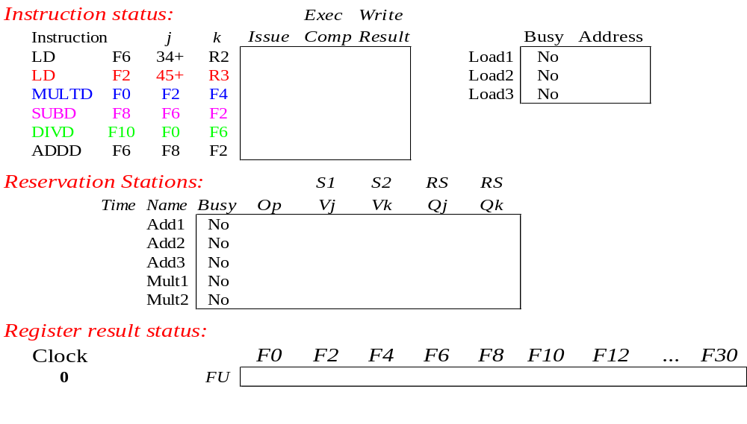
Tomasulo Example

Slide 46
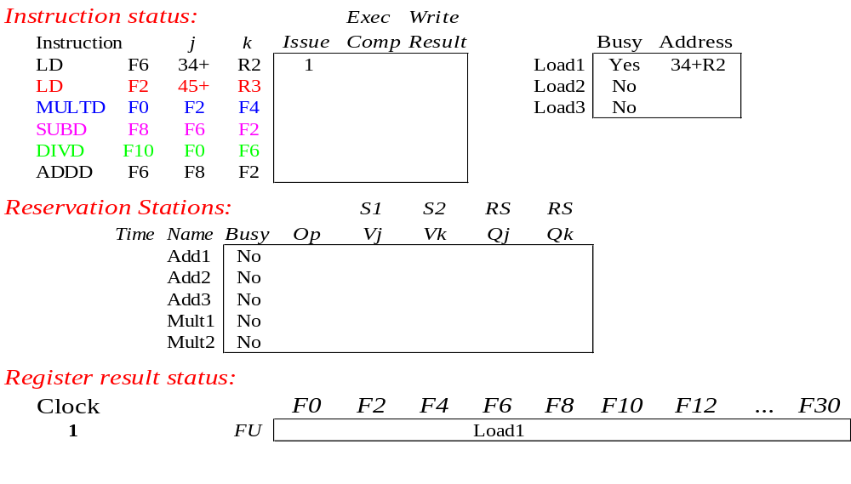
Tomasulo Example Cycle 1

Slide 47
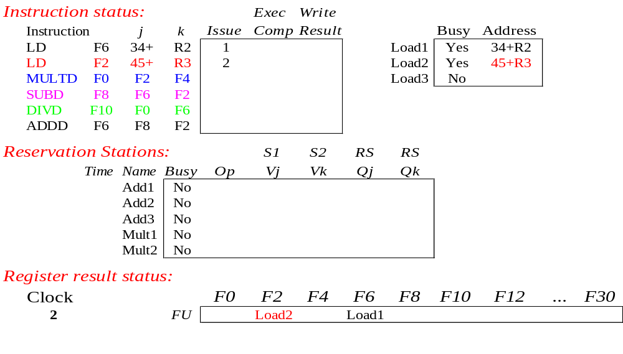
Tomasulo Example Cycle 2
Note: Unlike 6600, can have multiple loads outstanding

Slide 48
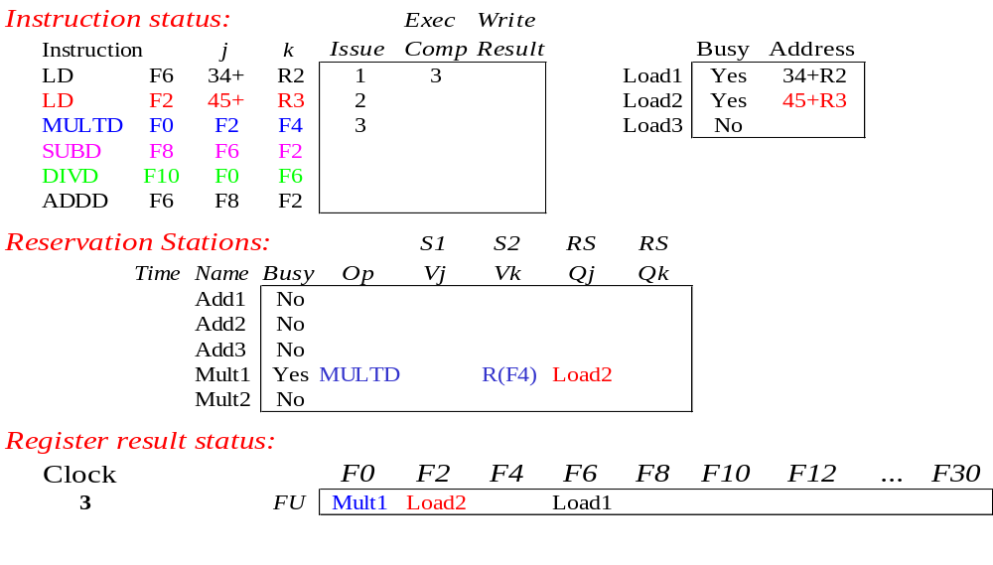
Tomasulo Example Cycle 3
Note: registers names are removed (“renamed”) in Reservation Stations; MULT issued vs. scoreboard
Load1 completing

Slide 49
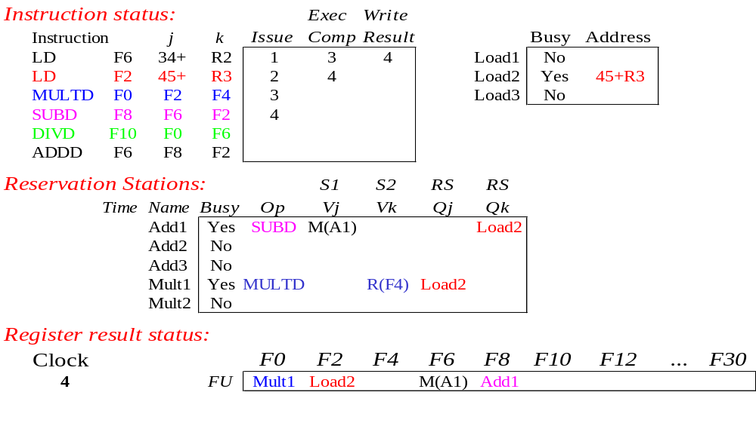
Tomasulo Example Cycle 4
Load2 completing

Slide 50
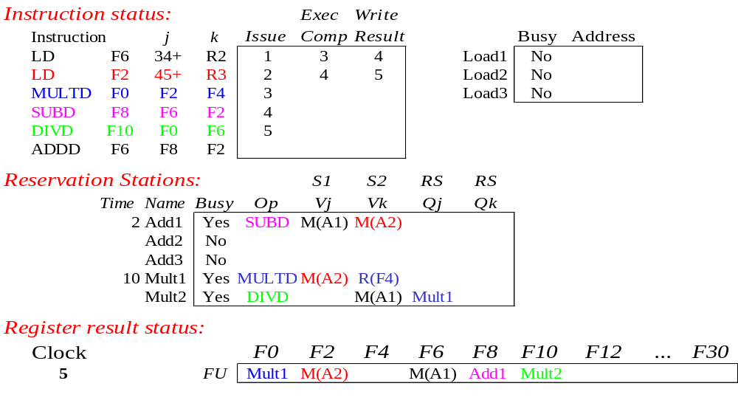
Tomasulo Example Cycle 5

Slide 51
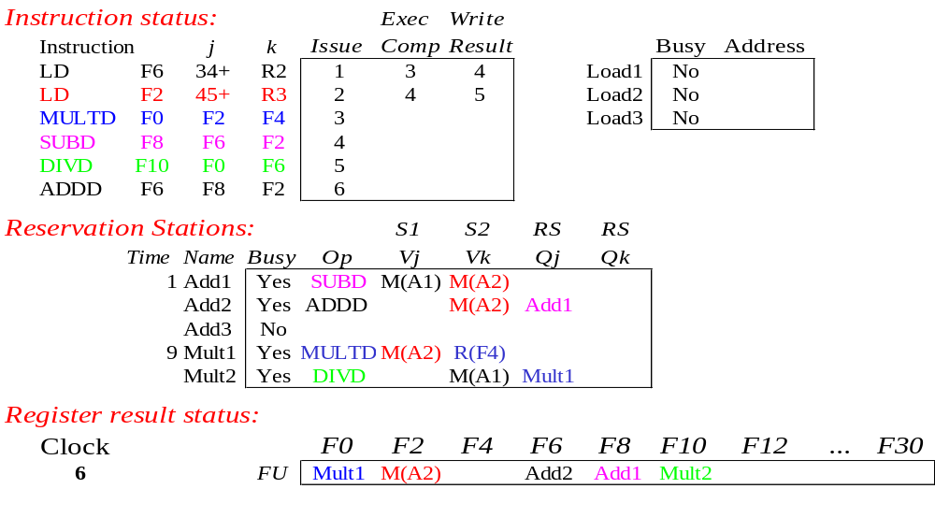
Tomasulo Example Cycle 6

Slide 52

Tomasulo Example Cycle 7
Add1 completing

Slide 53
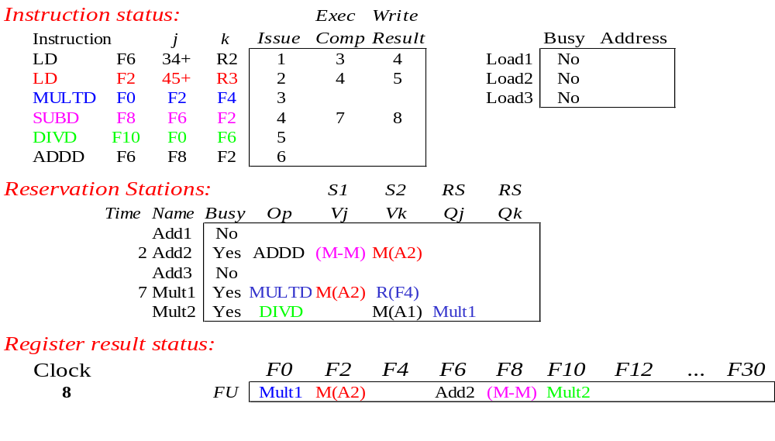
Tomasulo Example Cycle 8

Slide 54

Tomasulo Example Cycle 9

Slide 55

Tomasulo Example Cycle 10
Add2 completing

Slide 56
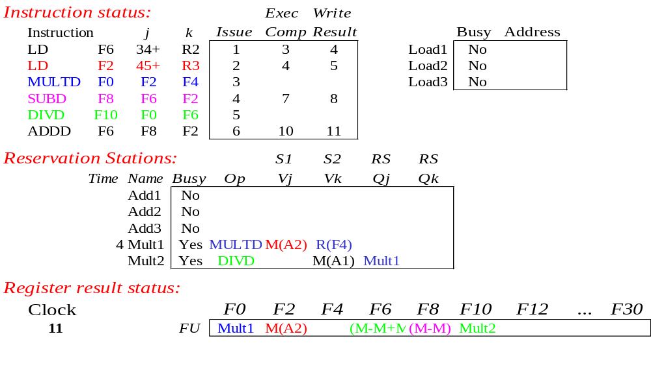
Tomasulo Example Cycle 11
All quick instructions complete in this cycle!

Slide 57

Tomasulo Example Cycle 12

Slide 58

Tomasulo Example Cycle 13

Slide 59

Tomasulo Example Cycle 14

Slide 60
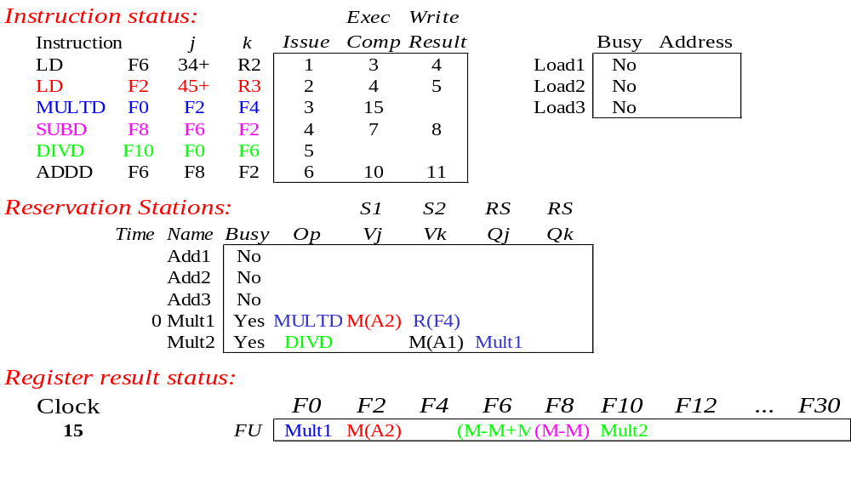
Tomasulo Example Cycle 15

Slide 61
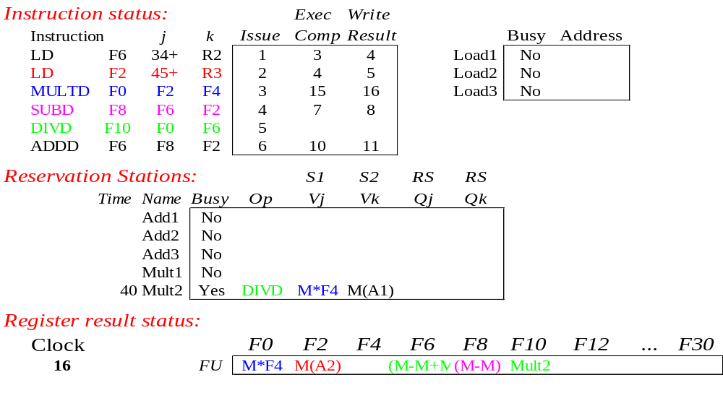
Tomasulo Example Cycle 16

Slide 62
After Some Cycles

Slide 63
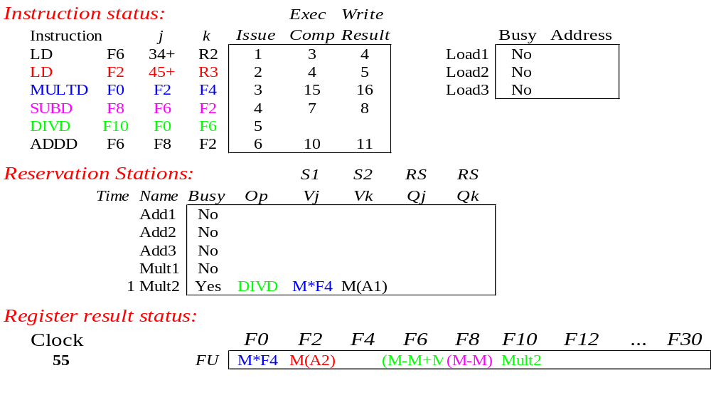
Tomasulo Example Cycle 55

Slide 64
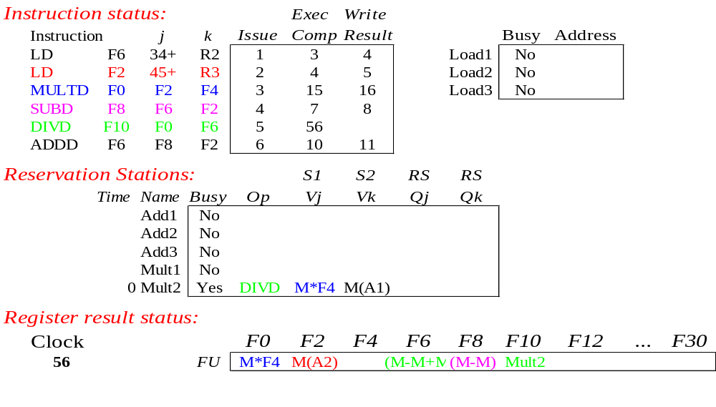
Tomasulo Example Cycle 56
Mult2 is completing; what is waiting for it?

Slide 65
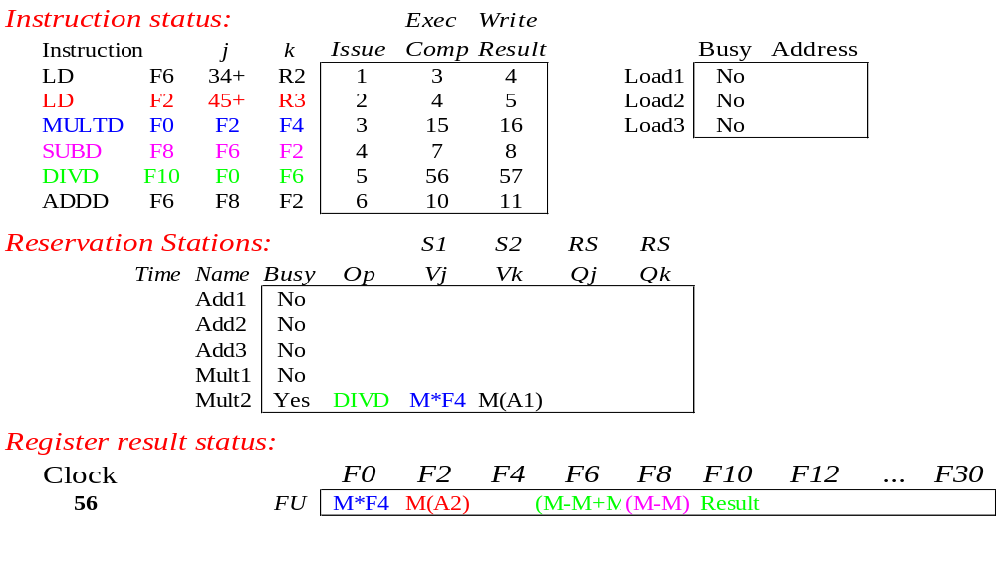
Tomasulo Example Cycle 57
Once again: In-order issue, out-of-order execution and completion.

Slide 66
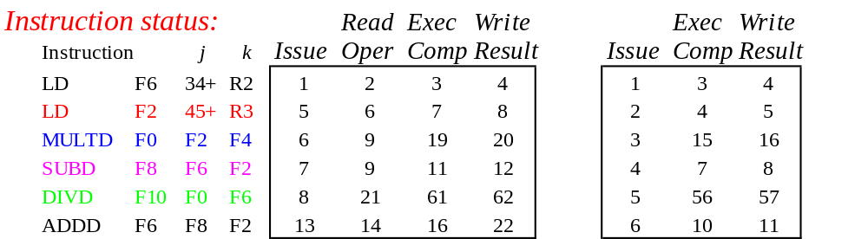
Compare to Scoreboard Cycle 62
Why take longer on scoreboard/6600?
  Structural Hazards
  Lack of forwarding

